Slide 1
Extraction of the Triggering Causes of a Query Event MSc Research Project Data Analytics Srijon Datta Student ID: 21225265 School of Computing National College of Ireland Supervisor: Prof. Vladimir Milosavljevic

Slide 2
Research Motivation

Slide 3
Motivating Factors
Importance of Causal Inference
Identifying causal relationships is essential for decision-making, policy formation, and problem-solving.
By examining the effectiveness of a supervised retrieval setup in enumerating plausible triggering causes, we can enhance our ability to make informed decisions and take appropriate actions.

Slide 4
Motivating Factors
Understanding Causal Relationships
Causal relationships play a fundamental role in many fields, including science, economics, healthcare, and social sciences.
Investigating how well a supervised retrieval setup can identify plausible triggering causes can contribute to a deeper understanding of causal relationships.

Slide 5
Motivating Factors
Potential for Improving Search Engines
Supervised retrieval setups have the potential to enhance the performance of search engines by providing more accurate and relevant results.
Understanding how well such setups can enumerate plausible triggering causes can lead to advancements in search algorithms and recommendation systems.

Slide 6
Research Novelty

Slide 7
Research Novelty
Focuses on Supervised Retrieval for Causal Inference
While there have been extensive studies on causal inference, the specific exploration of using a supervised retrieval setup to enumerate plausible triggering causes is relatively novel.
Most existing research in causal inference focuses on graphical models, experimental design, or counterfactual reasoning. By investigating the effectiveness of a supervised retrieval approach, we are exploring a different methodological perspective.

Slide 8
Research Question

Slide 9
Research Question
Given a causal query (rather any effect mentioned in the query), how well a supervised retrieval set up can enumerate the list of plausible triggering causes embedded in the documents?

Slide 10
Example...

Slide 11
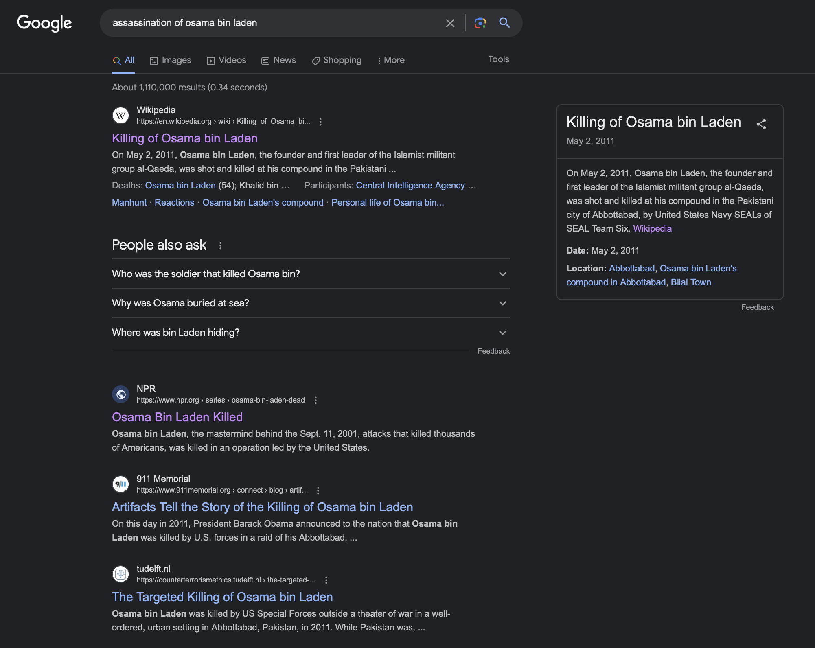
Assassination of 'Osama Bin Laden' let's Google this!
Is this what we are looking for?

Slide 12
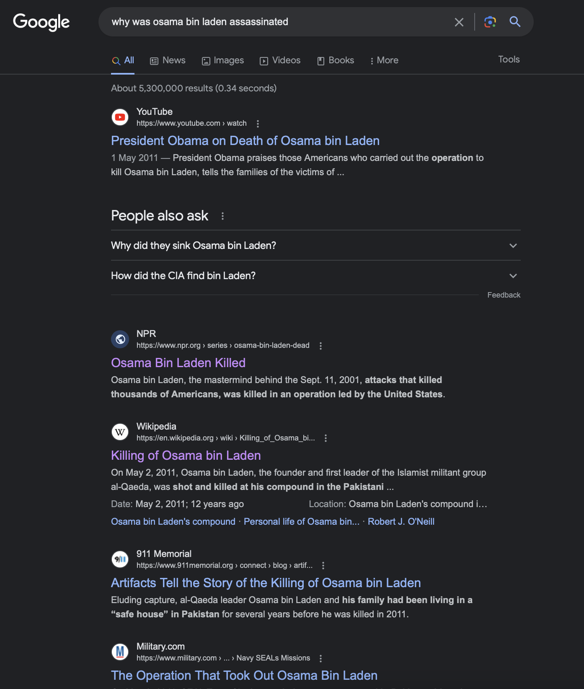

Now let's be more specific about our query this time! let's try …. Why was 'Osama Bin Laden' assassinated?
Anything changed?

Slide 13
..to address this gap, we start our investigation!

Slide 14
Understanding Data Collection

Slide 15
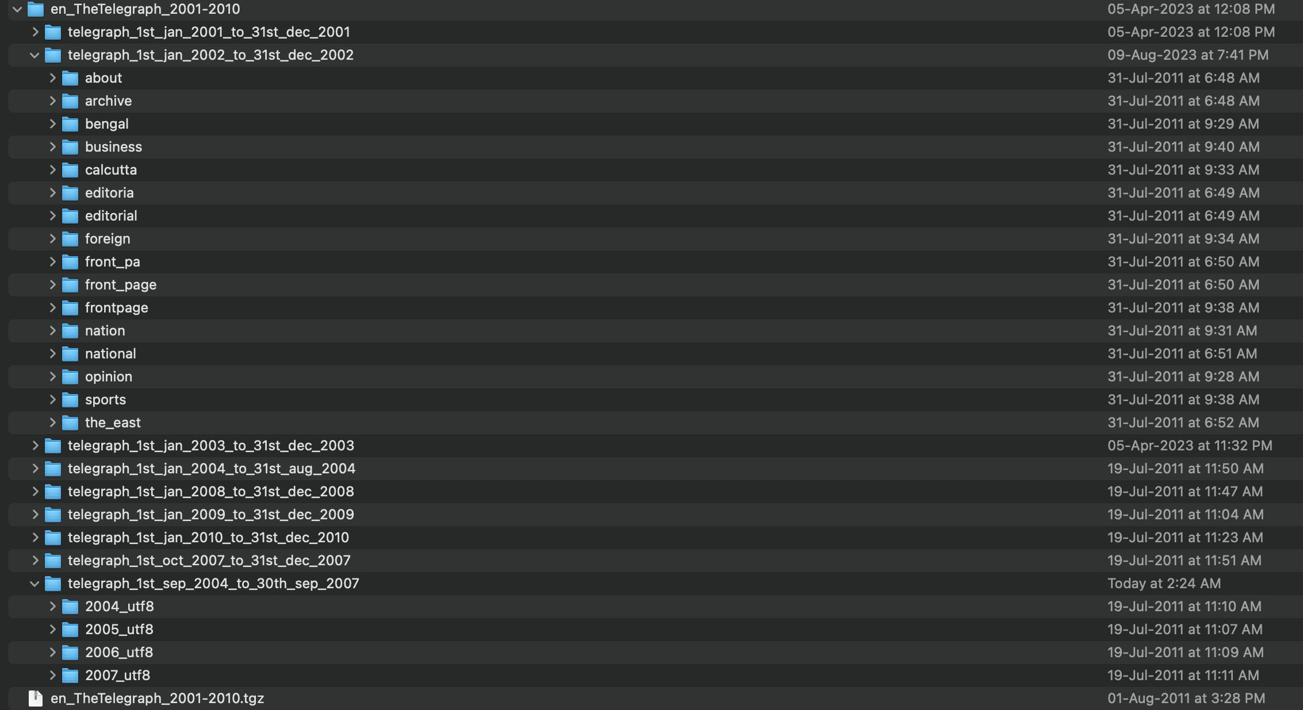
Target Collection

Slide 16
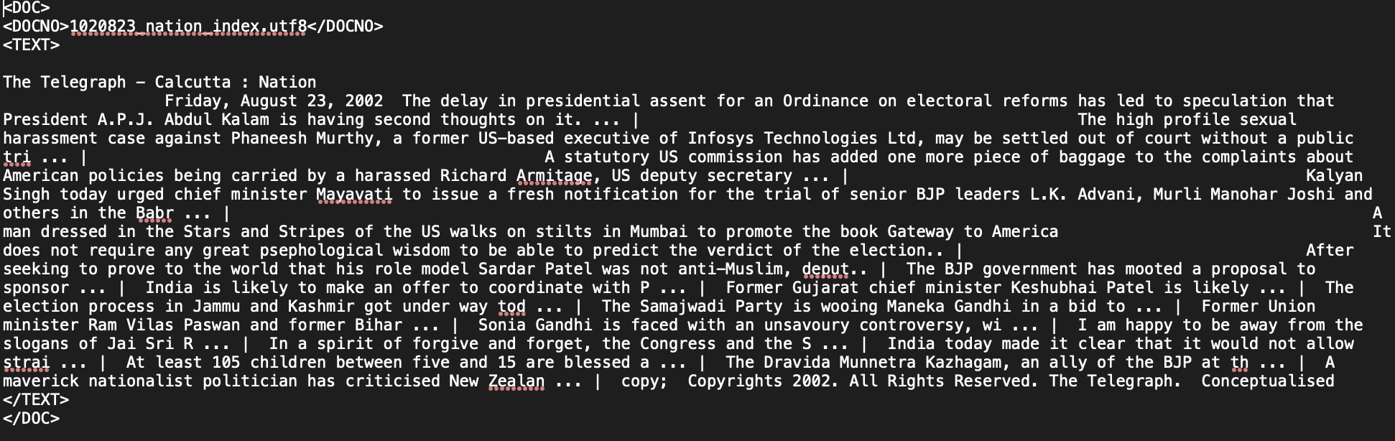
Target Collection

Slide 17
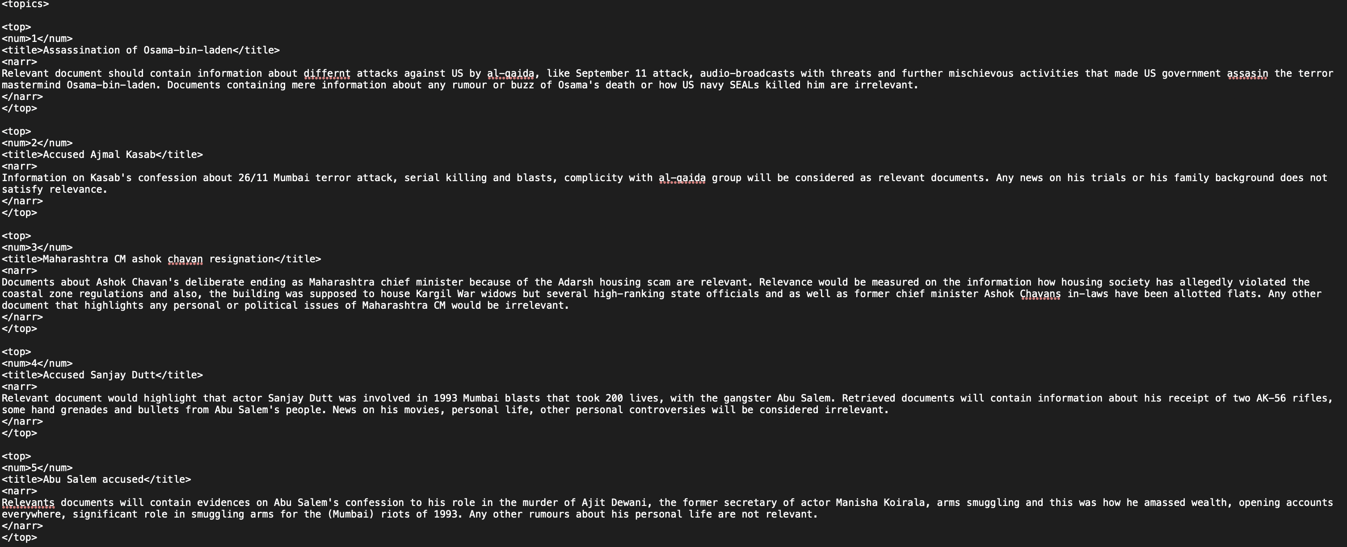
Topic Set The dataset contains 25 possible causal queries in total among which 20 queries randomly picked and used to train the models and 5 queries used for testing purpose.

Slide 18
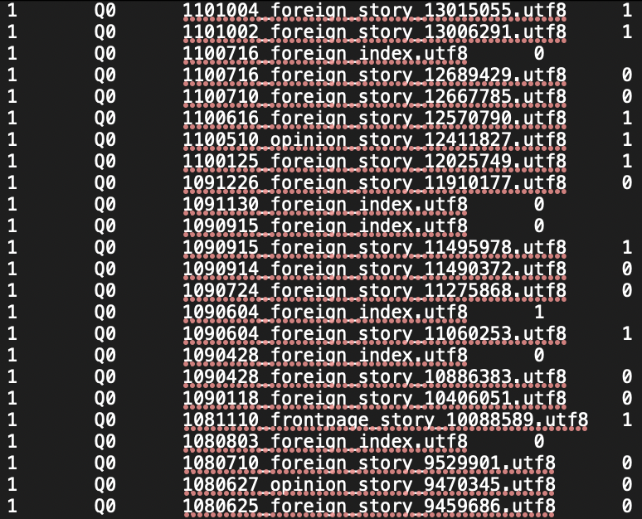
Relevance Judgement Set

Slide 19
Data Processing …

Slide 20
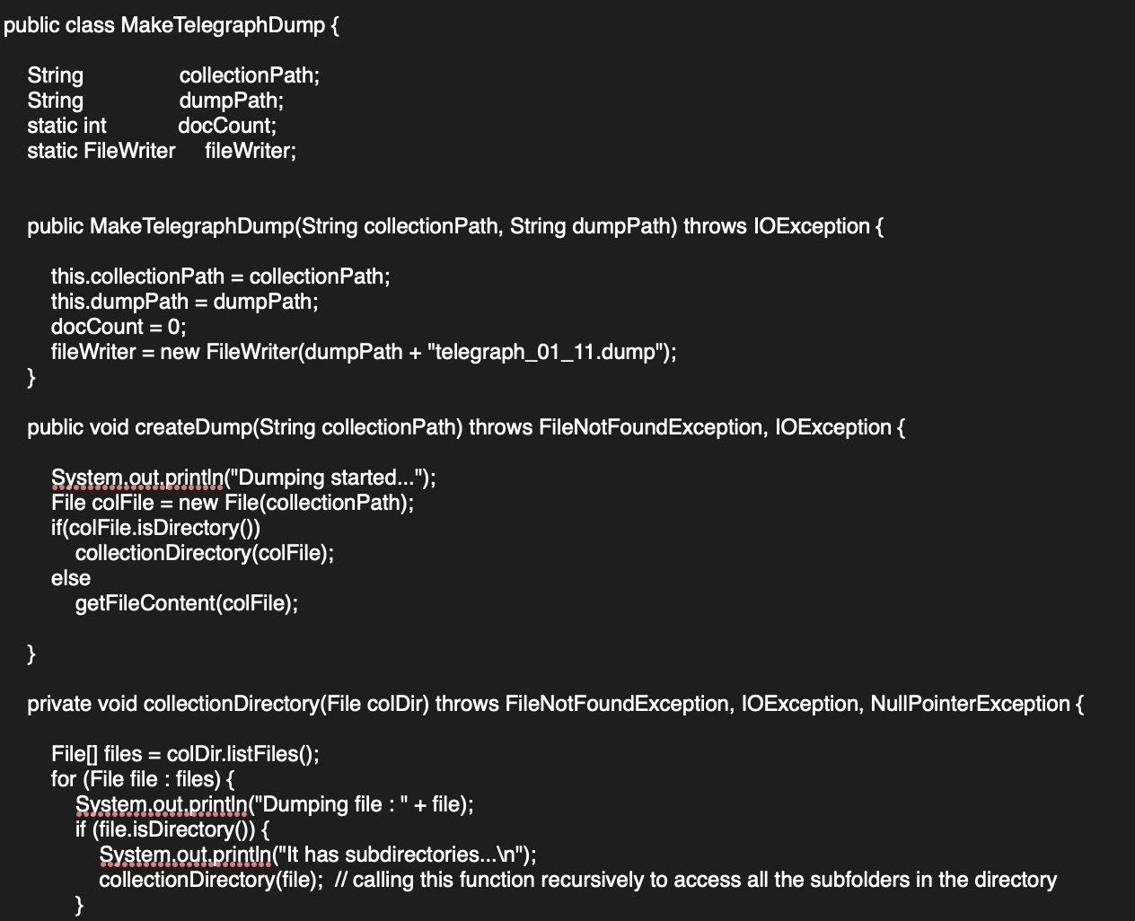
Dumping the Raw Text Collection

Slide 21
Overall Workflow

Slide 22
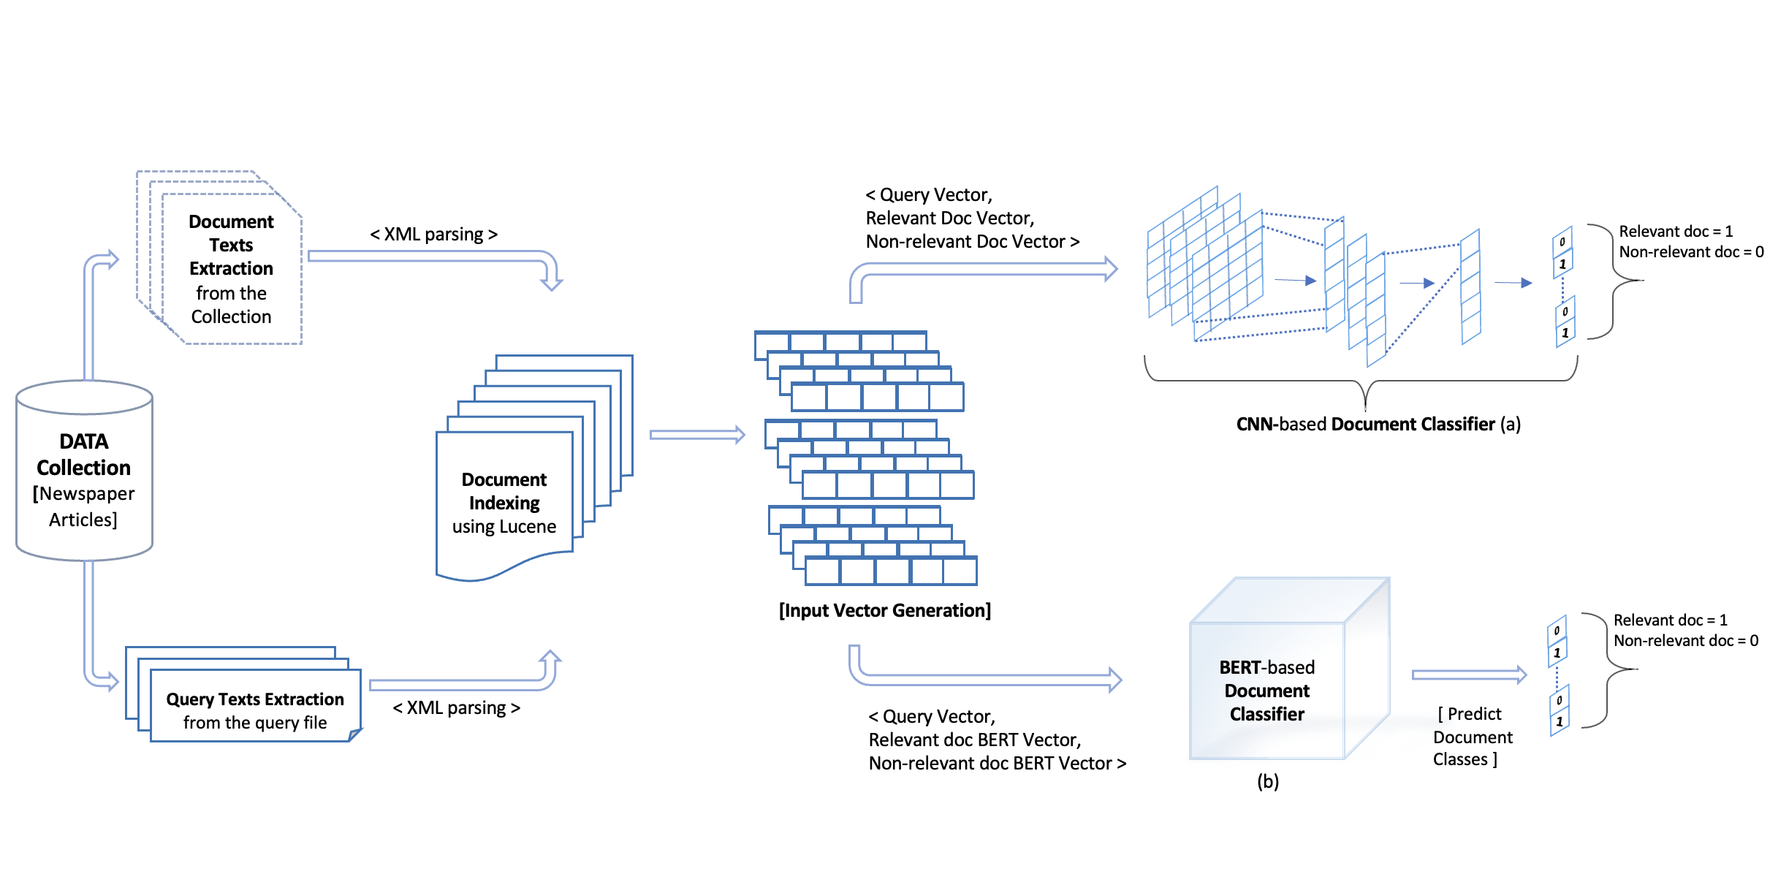

Slide 23
CNN Model Architecture

Slide 24
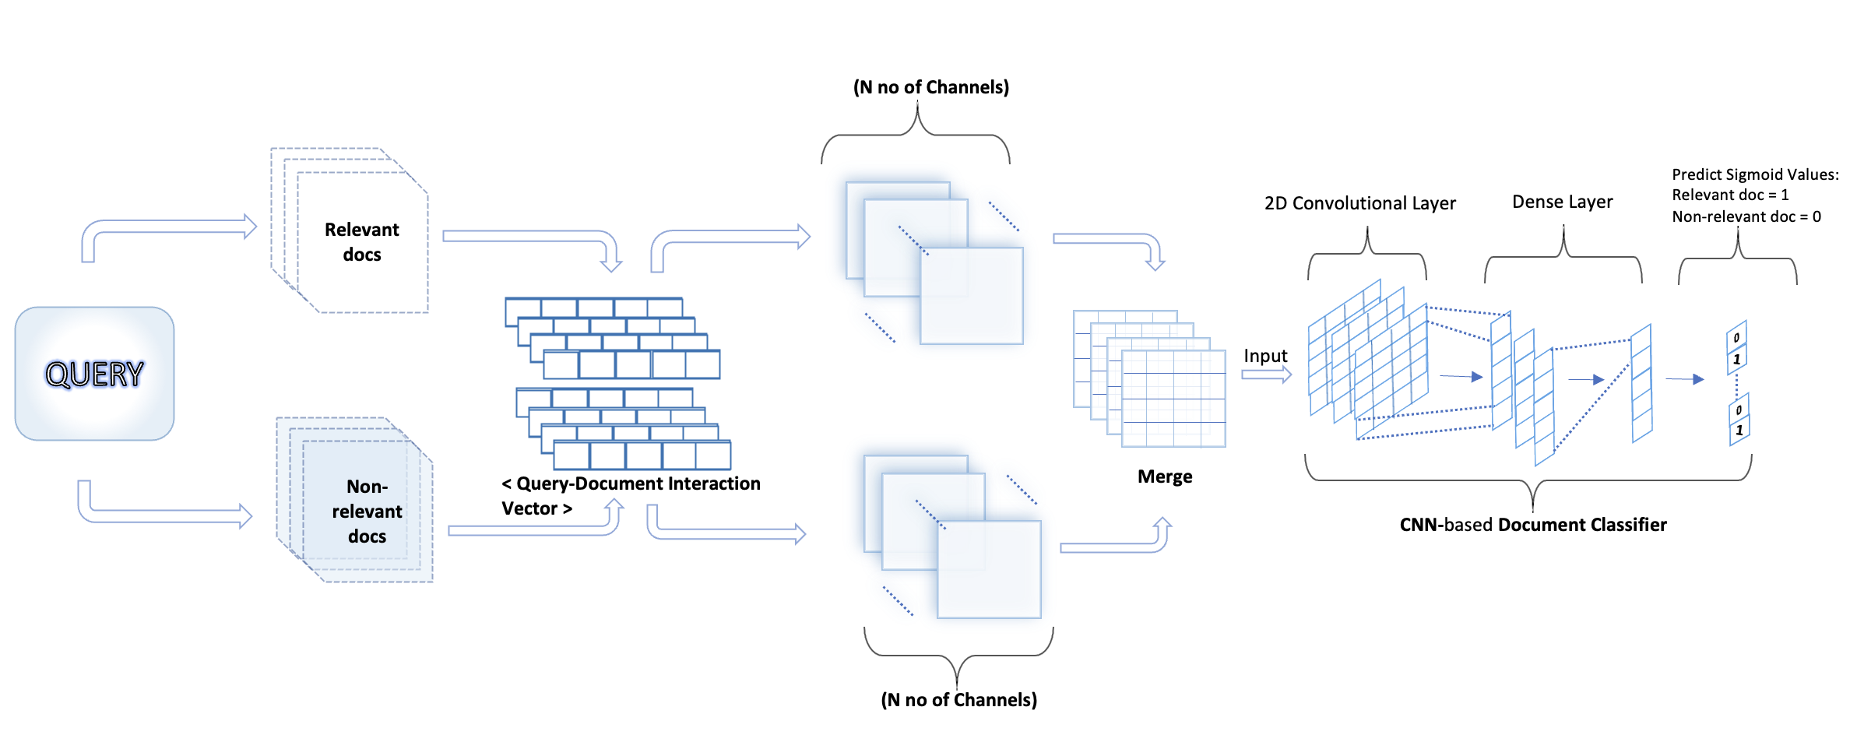

Slide 25
BERT Model Architecture

Slide 26
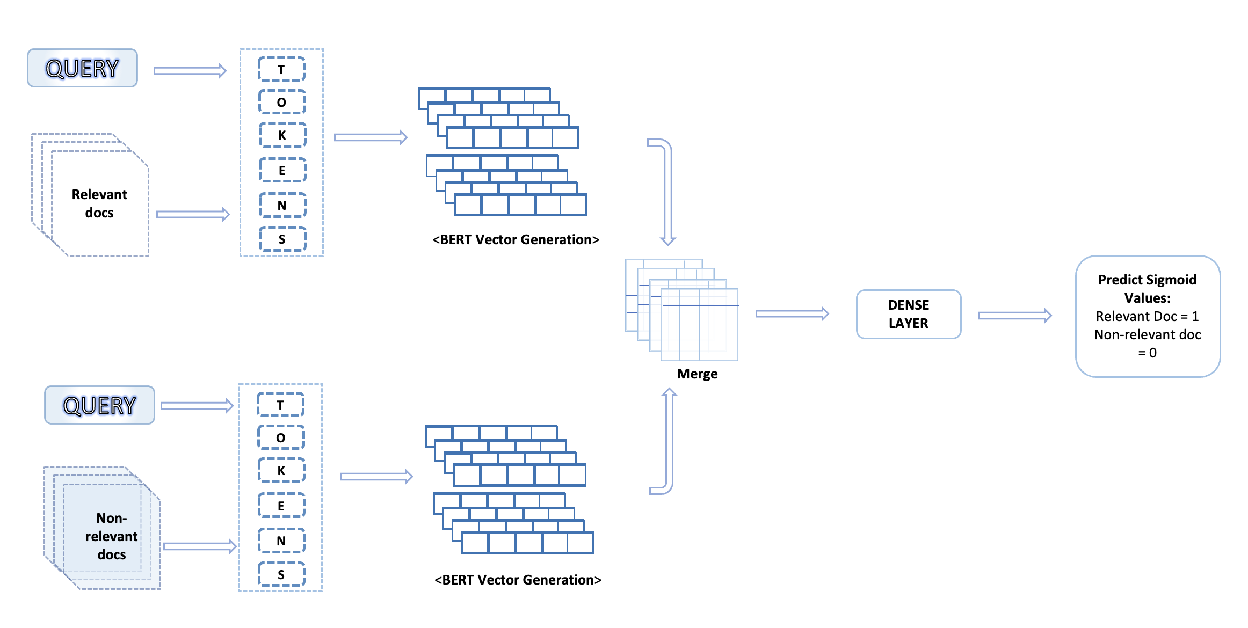

Slide 27
Models’ Performance Comparison

Slide 28
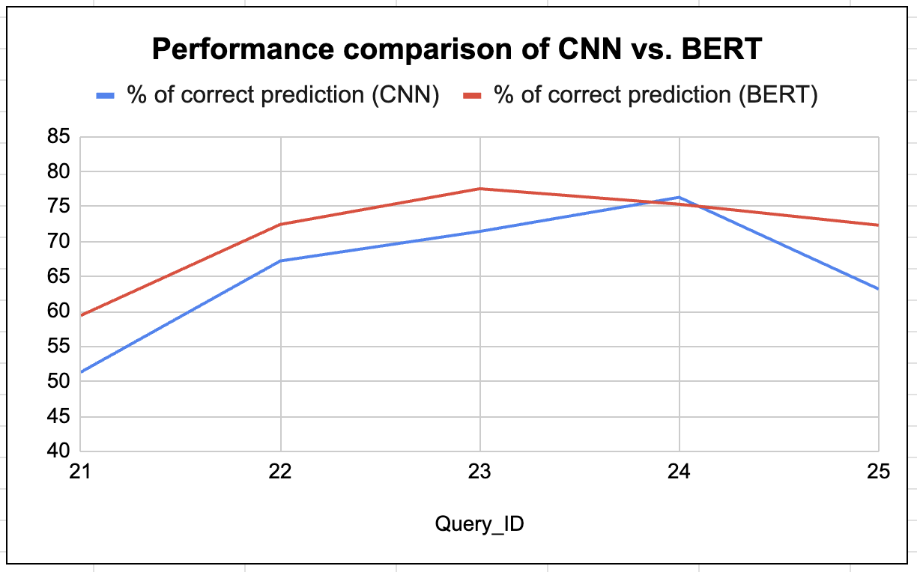

Slide 29
Thank You ..

